Slide 1
Intelligent Sentiment Classification on tweets
Under the supervison of : Mr. J. Arul Valan
By:
Lipokmerenla(2013105075)
Indrasen Singh(2013105071) Durga Shankar Mishra(2013105070)
COMPUTER SCIENCE AND ENGINEERING
National institute of technology nagaland

Slide 2
Content
Sentiment Analysis Introduction
Some Analyzed Points
Problem Statement
Objective
Proposed Work
Preprocessing
Algorithm
Decision Tree Classifier
Naïve Bayes Classifier
Implementation
Result
Future Work
Conclusion

Slide 3

Every second, there are around 8,222 tweets on Twitter.

Slide 4
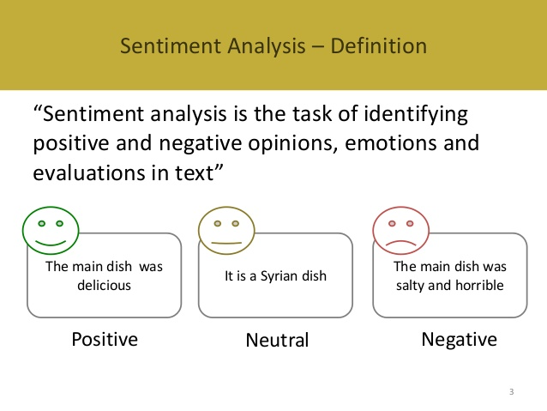

Slide 5
Problem Statement
The problem in sentiment analysis is classifying the polarity of a given tweet at the feature/aspect level.
Whether the expressed opinion in a document , a sentence or an entity feature/aspect is positive, negative or neutral.

Slide 6
Introduction
The booming Micro blog service, Twitter , attract more people to post their feelings and opinions on various topics.
The posting of sentiment contents can not only give an emotional snapshot of the online world but also have potential commercial and sociological values.
However, facing the massive sentiment tweets, it is hard for people to get overall impression without automatic sentiment classification and analysis.

Slide 7
Objective
To implement an algorithm for automatic classification of text into positive ,negative .
Sentimental Analysis to determine the attitude of the mass is positive , negative towards the subject of interest.
Graphical representation of the sentiment in the form of Graph.

Slide 8
Proposed Work

Slide 9
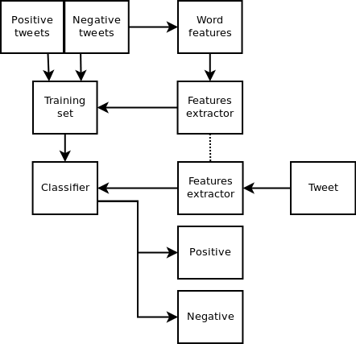

Slide 10
Preprocessing

Slide 11
Tokenization
Take character sequence
Chop it into pieces called tokens
Remove certain characters such as punctuation marks
A token is an instance of sequence of characters that are grouped together as a useful semantic unit for processing.

Slide 12
Lowercase Conversion
Tweet may be normalized by converting it to lowercase which makes it’s comparison with an English dictionary easier

Slide 13
Stop word removal
Some of the more frequently used stop words for English include "a", "of", "the", "I", "it", "you", and ”and” these are generally regarded as 'functional words' which do not carry meaning.

Slide 14
He @chetan_bhagat is the most successful writer in the history of Bollywood with successful films like #HalfGirlfriend #2States #3Idiots!
Convert the web addresses to “url”.
Convert @username to “at_user”.
Remove white spaces.
Replace #word with “at_user”.

Slide 15
ALGORITHM

Slide 16
1. DECISION TREE CLASSIFIER

Slide 17
Decision Tree Introduction
A decision tree is a tree with the following properties:
An inner node represents an attribute.
An edge represents a test on the attribute of the father node.
A leaf represents one of the classes.
Construction of a decision tree
Based on the training data
Top Down strategy

Slide 18
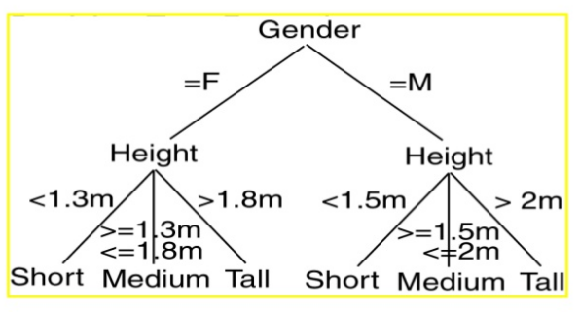
Decision Tree Example

Slide 19


Attribute Selection Measures
Information Gain :
The expected information needed to classify a tuple in D is given by
How much more information would we still need (after the partitioning) to arrive at an exact classification? This amount is measured by

Slide 20
The Decision tree algorithm
Until stopped:
Select a leaf node
Select one of the unused attributes
Partition the node population and calculate information gain
Find the split with maximum information gain for a this attribute
Repeat this for all attributes:
Find the best splitting attribute along with best split rule
Spilt the node using the attribute
Go to each child node and repeat step 2 to 4
Stopping criteria:
Each leaf-node contains examples of one type
Algorithm ran out of attributes
No further significant information gain

Slide 21
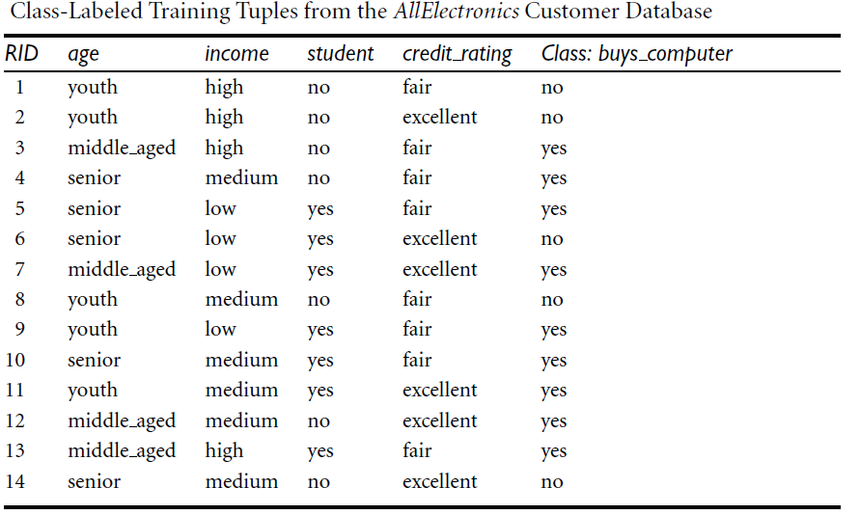

Slide 22


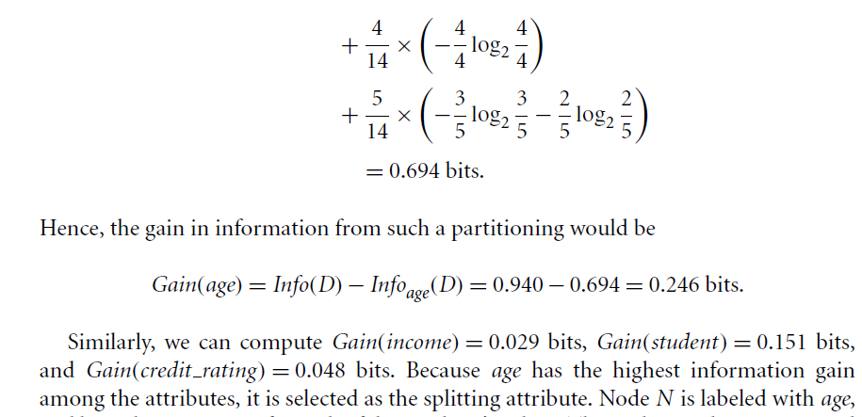

Slide 23
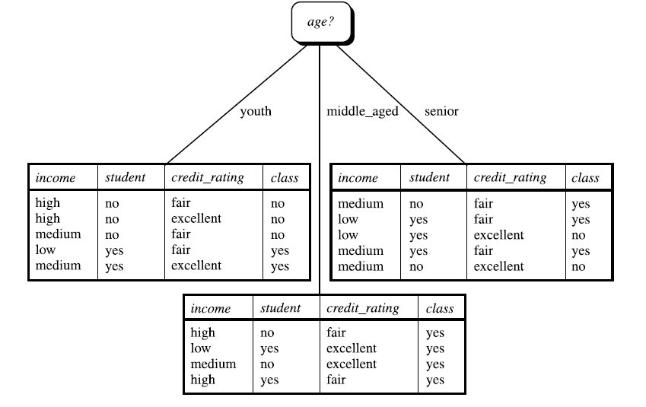

Slide 24
2.NAIVE BAYES CLASSIFIER

Slide 25
Introduction to Naïve Bayes :
Naive Bayes classifiers are a family of simple probabilistic classifiers based on applying Bayes' theorem with strong independence assumptions between the features.
Naive Bayes classifiers are highly scalable.
For some types of probability models, naive Bayes classifiers can be trained very efficiently.
Despite their naive design and oversimplified assumptions, it has worked quite well in many complex real-world situations.
It requires only a small number of training data to estimate the parameters necessary for classification

Slide 26
How it works
Bayes theorem provides a way of calculating the posterior probability, P(c|x) from P(c), P(x), and P(x|c).
Naive Bayes classifier assumes that the effect of the value of a predictor (x) on a given class (c) is independent of the values of other predictors.

Slide 27
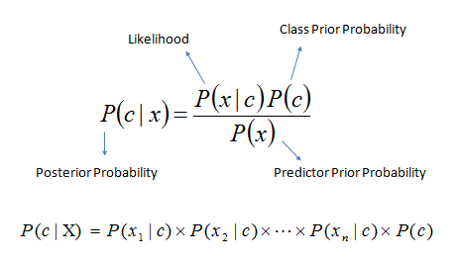
P(c|x) is the posterior probability of class (target) given predictor (attribute).
P(c) is the prior probability of class.
P(x|c) is the likelihood which is the probability of predictor given class.
P(x) is the prior probability of predictor.

Slide 28
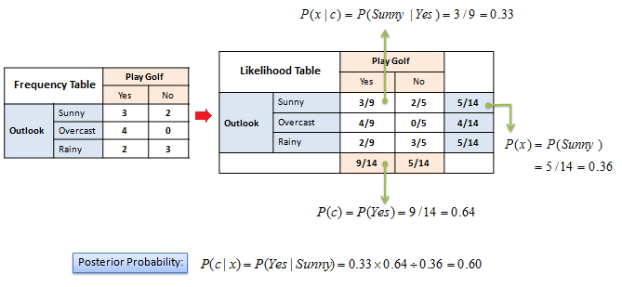
Example:
Figure : Example of Naïve Bayes

Slide 29
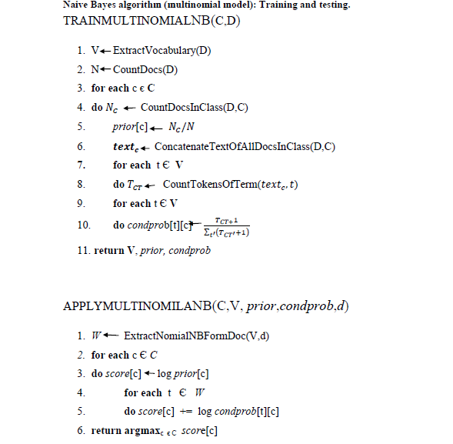
Text Classification by Naïve Bayes

Slide 30
Implementation
We are taking live tweets from twitter and we are performing sentiment analysis on it .
We have used various types of classifiers, and we have taken majority voting of these classifiers to predict more accurate results.
We have used bar-graph to show the accuracy of the various classifiers .
We have used live graph for better visualization of output.

Slide 31
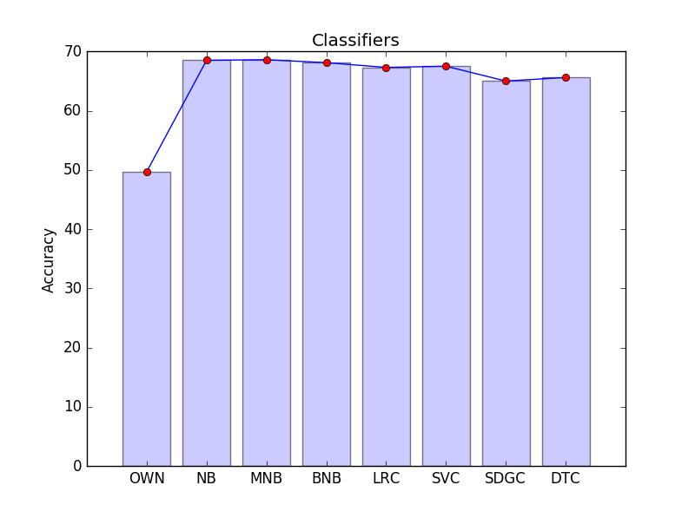
Result:

Slide 32
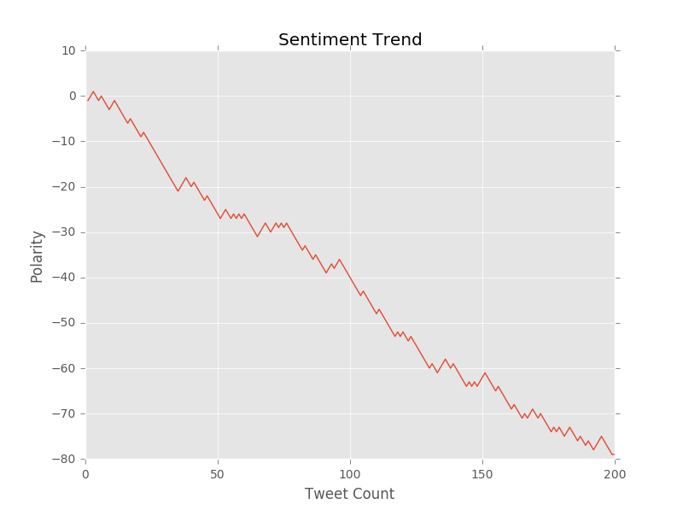
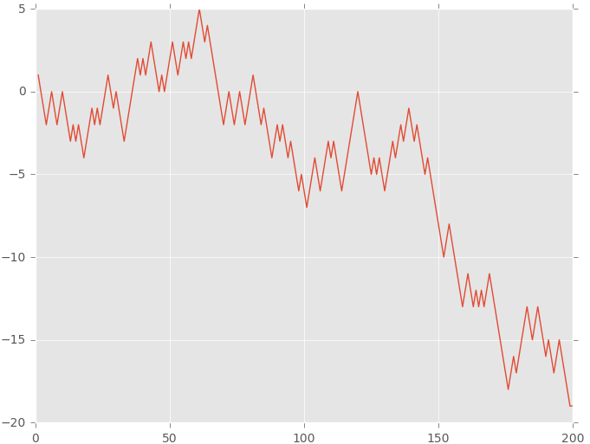
Result:

Slide 33
Future Work
The accuracy of the overall system can be improved.
Need to take care of the bigram .
Need to improve the performance of the word feature , so it can predict more accurately.

Slide 34
Concluding Remark
Visualizing the sentiment trends and intensities on tweet.

Slide 35
References
[1] B. J. Jansen, M. Zhang, K. Sobel, and A. Chowdury, “Twitter power: Tweets as
electronic word of mouth,” Journal of the American society for information science
and technology, vol. 60, no. 11, pp. 2169–2188, 2009.
[2]J.Bollean, H. Mao and X.Zeng "Twitter mood predict the stock market," Journal of
Computer Science , vol.2, no. 1 , pp. 1-8, 2011
[3] A. Tumasjan, T. O. Sprenger, P. G. Sandner, and I. M. Welpe, “Predicting
elections with twitter: What 140 characters reveal about political sentiment.”
ICWSM, vol. 10, pp. 178–185, 2010
[4] M. Thelwall, K. Buckley, and G. Paltoglou, “Sentiment in twitter events,” Journal
of the American Society for Information Science and Technology, vol. 62, no. 2, pp.
406–418, 2011.
[5] A. Agarwal, B. Xie, I. Vovsha, O. Rambow, and R. Passonneau, “Sentiment
analysis of twitter data,” in Proceedings of the Workshop on Languages in Social
Media. Association for Computational Linguistics, 2011, pp. 30–38

Slide 36


